Slide 1
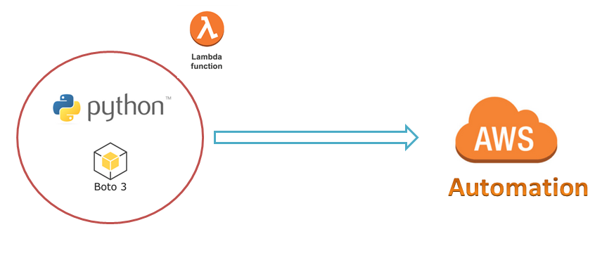
AWS Automation
with
boto3 of Python and Lambda Functions
Loop control statements or commands
(break and continue)
What do you need for this course ?
Learn how to automate AWS common tasks using boto3 and Lambda

Slide 2

What do you need for this course ?
AWS Account
It is great if you have free tier account
Basic Knowledge on AWS Services and Python
Basic knowledge on Any Python IDLE ( PyCharm or Atom or sublime Text ) or at least vi/vim editor for command line.
Loop control statements or commands
(break and continue)
Learn how to automate AWS common tasks using boto3 and Lambda

Slide 3
Thank you

